Slide 1
Reference attribute grammar controlled graph rewriting
Motivation and overview
Christoff Bürger
christoff.buerger@gmail.com

Slide 2
The problem What do you want?
Interactive, mutual-dependent analyses & transformations

Slide 3
From batch to interactive
syntax-directed analyses
graph-based transformations
compiler
frontend
(abstract syntax tree)
backend
(graph)
input
(source code)
output
(binary code/
code for further tooling)
passes

Slide 4
From batch to interactive
syntax-directed analyses
attribute grammar
graph-based transformations
compiler
frontend
(abstract syntax tree)
backend
(graph)
AG
input
(abstract syntax tree)
automatically
scheduled
output
(binary code/
code for further tooling)
strategies

Slide 5
From batch to interactive
syntax-directed analyses
demand-driven reference attribute grammar
graph-based transform.
compiler
frontend
(abstract syntax graph)
backend
(graph)
RAG
demand
input
(abstract syntax tree)
demand
driven
output
(binary code/
code for further tooling)
strategies

Slide 6
From batch to interactive
syntax-directed analyses
demand-driven reference attribute grammar
graph-based transform.
compiler
frontend
(abstract syntax graph)
backend
(graph)
RAG
input
(abstract syntax tree)
demand
driven
output
(binary code/
code for further tooling)
strategies

Slide 7
From batch to interactive
interaction
syntax-directed analyses
demand-driven reference attribute grammar
graph-based transform.
compiler
frontend
(abstract syntax graph)
backend
(graph)
interactive, mutual-dependent analyses & transformations
RAG
input
(abstract syntax tree)
demand
driven
output
(binary code/
code for further tooling)
strategies

Slide 8
From batch to interactive
interaction
syntax-directed analyses & transformations
reference attribute grammar controlled graph rewriting
?
limitations of application
open research question
compiler
model of language
(abstract syntax graph)
?
interactive, mutual-dependent analyses & transformations
analyses guide transformations
RACR
transformations invalidate analyses
input
(abstract syntax tree)
automatically deduced dependencies
output
(binary code/
code for further tooling)
language processor

Slide 9
The solution What is RAG-controlled rewriting?
Reference attribute grammars, abstract syntax graphs, RAG-controlled rewriting & RACR¹
¹ https://github.com/christoff-buerger/racr

Slide 10
Reference attribute grammars & ASGs
Program
decl a : integer
Begin
use b ; Error
use a
decl a : real
use a
End
use a
decl a : real ; Error
End

Slide 11
Reference attribute grammars & ASGs
Prog
T
typed AST node
abstract syntax tree
v
terminal value
AST edge
Stmt*
DErr
Decl
Block
Use
Decl
Program
decl a : integer
Begin
use b ; Error
use a
decl a : real
use a
End
use a
decl a : real ; Error
End
Integer
a
Stmt*
a
Real
a
Use
Use
Decl
Use
b
a
Real
a
a

Slide 12
Reference attribute grammars & ASGs
Prog
T
typed AST node
abstract syntax tree
v
terminal value
AST edge
Stmt*
DErr
t
g
name analysis
t
type analysis
Decl
w
Block
g
Use
t
w
Decl
w
w
well-formedness
Program
decl a : integer
Begin
use b ; Error
use a
decl a : real
use a
End
use a
decl a : real ; Error
End
Integer
a
Stmt*
a
Real
a
g
Use
t
w
g
Use
t
w
Decl
w
g
Use
t
w
b
a
Real
a
a

Slide 13
Reference attribute grammars & ASGs
Prog
T
typed AST node
abstract syntax tree
v
terminal value
ASG
abstract syntax graph
AST edge
Stmt*
DErr
t
g
name analysis
t
semantic
overlay graph
type analysis
Decl
w
Block
g
Use
t
w
Decl
w
w
well-formedness
Program
decl a : integer
Begin
use b ; Error
use a
decl a : real
use a
End
use a
decl a : real ; Error
End
Integer
a
Stmt*
a
Real
a
g
Use
t
w
g
Use
t
w
Decl
w
g
Use
t
w
b
a
Real
a
a

Slide 14
RAG-controlled rewriting
RAG-controlled rewriting = RAGs + rewriting
RAG for declarative analyses
graph rewriting for declarative ASG transformations
seamless combination:
use of analyses to deduce rewrites
rewrites automatically update analyses
>> incremental
mutual control

Slide 15
RACR
Reference implementation of RAG-controlled rewriting in Scheme.
https://github.com/christoff-buerger/racr

Slide 16
The implementation How works RAG-controlled rewriting?
Dynamic attribute dependency graphs & incremental evaluation

Slide 17

Query & rewrite functions
well balanced set of functions
query functions to access ASG
add dependencies on queried information
rewrite functions to change ASG
invalidate attributes depending on rewritten information
→
←
query functions
Prog
rewrite functions
Stmt*
DErr
t
only way to query ASG
used in attribute equations
a
g
Decl
a
l
t
w
a
g
Block
b
l
a
g
Use
l
t
w
a
g
Decl
l
t
w
only way to change ASG
used for transformations
index
b
b
index
index
index
Integer
a
Stmt*
a
Real
a
b
g
Use
a
l
t
w
a
g
Use
a
l
t
w
a
g
Decl
a
l
t
w
a
g
Use
l
t
w
index
b
index
index
index
b
a
Real
a
a
construct
dynamic attribute
dependency graph
invalidate
demand-driven evaluation avoids unnecessary computations

Slide 18
Query & rewrite functions
query functions
rewrite functions
(=Name n . a) value of attribute Name
(->c n) child c of n (c can be index)
(<- n) parent of n
(->c? n) has n a c child (c can be index)
(<-? n) has n a parent
(index n) child-position of n
(num-children n) number of children of n
(T=? n) is n exactly of type T
(T<? n) is n subtype of type T
(T>? n) is n supertype of type T
({=,<,>}? n1 n2) is n1 {=,<,>}-type of n2
(find f n . b) find child of n satisfying f
(r-subtree n1 n2) replace n1 by n2
(r-terminal t v) replace value of terminal t
(add n l) add n to list l
(insert n i l) insert n at position i in l
(delete n) delete list element n
(refine n T . c) refine n to subtype T
(abstract n T) abstract n to supertype T
dependency types
value, exists, has-child(child/index), has-parent, index, num-children, type, subtype(T), supertype(T)

Slide 19
Dynamic attribute dependency graphs
(ag-rule G-Decl ; Inherited attribute
((Block Stmt*) ; Equation for statements of blocks
(lambda (n name)
(or (find-L-Decl name (<- n) (index n))
(=G-Decl (<- (<- n)) name))))
((Prog Stmt*) ; Equation for statements of programs
(lambda (n name)
(or (find-L-Decl name (<- n) (index n))
(->DErr (<- (<- n)))))))
Prog
Stmt*
DErr
Decl
Block
Use
Decl
Integer
a
queried information
a
a
Stmt*
Real
(ag-rule L-Decl ; Synthesised attribute
(Stmt (lambda (n name) #f))
(Decl (lambda (n name)
(if (=? (->name n) name) n #f))))
Use
Use
t
Decl
Use
(ag-rule Type ; Synthesised attribute
(Use (lambda (n) (=Type (=G-Decl n (->name n)))))
(Decl (lambda (n) (->type n)))
b
a
Real
a
a

Slide 20
Dynamic attribute dependency graphs
(ag-rule G-Decl ; Inherited attribute
((Block Stmt*) ; Equation for statements of blocks
(lambda (n name)
(or (find-L-Decl name (<- n) (index n))
(=G-Decl (<- (<- n)) name))))
((Prog Stmt*) ; Equation for statements of programs
(lambda (n name)
(or (find-L-Decl name (<- n) (index n))
(->DErr (<- (<- n)))))))
Prog
Stmt*
DErr
Decl
Block
Use
Decl
Integer
a
Stmt*
a
Real
a
(ag-rule L-Decl ; Synthesised attribute
(Stmt (lambda (n name) #f))
(Decl (lambda (n name)
(if (=? (->name n) name) n #f))))
Use
Use
t
Decl
Use
1
(ag-rule Type ; Synthesised attribute
(Use (lambda (n) (=Type (=G-Decl n (->name n)))))
(Decl (lambda (n) (->type n)))
b
a
Real
a
a

Slide 21
Dynamic attribute dependency graphs
(ag-rule G-Decl ; Inherited attribute
((Block Stmt*) ; Equation for statements of blocks
(lambda (n name)
(or (find-L-Decl name (<- n) (index n))
(=G-Decl (<- (<- n)) name))))
((Prog Stmt*) ; Equation for statements of programs
(lambda (n name)
(or (find-L-Decl name (<- n) (index n))
(->DErr (<- (<- n)))))))
Prog
Stmt*
DErr
Decl
Block
Use
Decl
Integer
a
Stmt*
a
Real
a
(ag-rule L-Decl ; Synthesised attribute
(Stmt (lambda (n name) #f))
(Decl (lambda (n name)
(if (=? (->name n) name) n #f))))
2
Use
a
g
Use
t
Decl
Use
1
(ag-rule Type ; Synthesised attribute
(Use (lambda (n) (=Type (=G-Decl n (->name n)))))
(Decl (lambda (n) (->type n)))
b
a
Real
a
a

Slide 22
Dynamic attribute dependency graphs
(ag-rule G-Decl ; Inherited attribute
((Block Stmt*) ; Equation for statements of blocks
(lambda (n name)
(or (find-L-Decl name (<- n) (index n))
(=G-Decl (<- (<- n)) name))))
((Prog Stmt*) ; Equation for statements of programs
(lambda (n name)
(or (find-L-Decl name (<- n) (index n))
(->DErr (<- (<- n)))))))
Prog
Stmt*
DErr
Decl
Block
Use
Decl
Integer
a
Stmt*
a
Real
a
(ag-rule L-Decl ; Synthesised attribute
(Stmt (lambda (n name) #f))
(Decl (lambda (n name)
(if (=? (->name n) name) n #f))))
2
Use
a
g
Use
t
Decl
Use
3
index
(ag-rule Type ; Synthesised attribute
(Use (lambda (n) (=Type (=G-Decl n (->name n)))))
(Decl (lambda (n) (->type n)))
1
b
a
Real
a
a

Slide 23
Dynamic attribute dependency graphs
(ag-rule G-Decl ; Inherited attribute
((Block Stmt*) ; Equation for statements of blocks
(lambda (n name)
(or (find-L-Decl name (<- n) (index n))
(=G-Decl (<- (<- n)) name))))
((Prog Stmt*) ; Equation for statements of programs
(lambda (n name)
(or (find-L-Decl name (<- n) (index n))
(->DErr (<- (<- n)))))))
Prog
Stmt*
DErr
Decl
Block
Use
Decl
Integer
a
Stmt*
a
Real
a
(ag-rule L-Decl ; Synthesised attribute
(Stmt (lambda (n name) #f))
(Decl (lambda (n name)
(if (=? (->name n) name) n #f))))
4
2
Use
a
l
a
g
Use
t
Decl
Use
3
index
(ag-rule Type ; Synthesised attribute
(Use (lambda (n) (=Type (=G-Decl n (->name n)))))
(Decl (lambda (n) (->type n)))
1
b
a
Real
a
a

Slide 24
Dynamic attribute dependency graphs
(ag-rule G-Decl ; Inherited attribute
((Block Stmt*) ; Equation for statements of blocks
(lambda (n name)
(or (find-L-Decl name (<- n) (index n))
(=G-Decl (<- (<- n)) name))))
((Prog Stmt*) ; Equation for statements of programs
(lambda (n name)
(or (find-L-Decl name (<- n) (index n))
(->DErr (<- (<- n)))))))
Prog
Stmt*
DErr
Decl
Block
Use
Decl
Integer
a
Stmt*
a
Real
a
(ag-rule L-Decl ; Synthesised attribute
(Stmt (lambda (n name) #f))
(Decl (lambda (n name)
(if (=? (->name n) name) n #f))))
5
4
2
Use
a
l
a
g
Use
a
l
t
Decl
Use
3
index
(ag-rule Type ; Synthesised attribute
(Use (lambda (n) (=Type (=G-Decl n (->name n)))))
(Decl (lambda (n) (->type n)))
1
b
a
Real
a
a

Slide 25
Dynamic attribute dependency graphs
(ag-rule G-Decl ; Inherited attribute
((Block Stmt*) ; Equation for statements of blocks
(lambda (n name)
(or (find-L-Decl name (<- n) (index n))
(=G-Decl (<- (<- n)) name))))
((Prog Stmt*) ; Equation for statements of programs
(lambda (n name)
(or (find-L-Decl name (<- n) (index n))
(->DErr (<- (<- n)))))))
Prog
Stmt*
DErr
Decl
6
a
g
Block
Use
Decl
Integer
a
Stmt*
a
Real
a
(ag-rule L-Decl ; Synthesised attribute
(Stmt (lambda (n name) #f))
(Decl (lambda (n name)
(if (=? (->name n) name) n #f))))
5
4
2
Use
a
l
a
g
Use
a
l
t
Decl
Use
3
index
(ag-rule Type ; Synthesised attribute
(Use (lambda (n) (=Type (=G-Decl n (->name n)))))
(Decl (lambda (n) (->type n)))
1
b
a
Real
a
a

Slide 26
Dynamic attribute dependency graphs
(ag-rule G-Decl ; Inherited attribute
((Block Stmt*) ; Equation for statements of blocks
(lambda (n name)
(or (find-L-Decl name (<- n) (index n))
(=G-Decl (<- (<- n)) name))))
((Prog Stmt*) ; Equation for statements of programs
(lambda (n name)
(or (find-L-Decl name (<- n) (index n))
(->DErr (<- (<- n)))))))
Prog
Stmt*
DErr
7
Decl
6
a
g
Block
Use
Decl
index
Integer
a
Stmt*
a
Real
a
(ag-rule L-Decl ; Synthesised attribute
(Stmt (lambda (n name) #f))
(Decl (lambda (n name)
(if (=? (->name n) name) n #f))))
5
4
2
Use
a
l
a
g
Use
a
l
t
Decl
Use
3
index
(ag-rule Type ; Synthesised attribute
(Use (lambda (n) (=Type (=G-Decl n (->name n)))))
(Decl (lambda (n) (->type n)))
1
b
a
Real
a
a

Slide 27
Dynamic attribute dependency graphs
(ag-rule G-Decl ; Inherited attribute
((Block Stmt*) ; Equation for statements of blocks
(lambda (n name)
(or (find-L-Decl name (<- n) (index n))
(=G-Decl (<- (<- n)) name))))
((Prog Stmt*) ; Equation for statements of programs
(lambda (n name)
(or (find-L-Decl name (<- n) (index n))
(->DErr (<- (<- n)))))))
Prog
8
Stmt*
DErr
7
Decl
a
l
6
a
g
Block
Use
Decl
index
Integer
a
Stmt*
a
Real
a
(ag-rule L-Decl ; Synthesised attribute
(Stmt (lambda (n name) #f))
(Decl (lambda (n name)
(if (=? (->name n) name) n #f))))
5
4
2
Use
a
l
a
g
Use
a
l
t
Decl
Use
3
index
(ag-rule Type ; Synthesised attribute
(Use (lambda (n) (=Type (=G-Decl n (->name n)))))
(Decl (lambda (n) (->type n)))
1
b
a
Real
a
a

Slide 28
Dynamic attribute dependency graphs
(ag-rule G-Decl ; Inherited attribute
((Block Stmt*) ; Equation for statements of blocks
(lambda (n name)
(or (find-L-Decl name (<- n) (index n))
(=G-Decl (<- (<- n)) name))))
((Prog Stmt*) ; Equation for statements of programs
(lambda (n name)
(or (find-L-Decl name (<- n) (index n))
(->DErr (<- (<- n)))))))
Prog
8
Stmt*
DErr
7
Decl
a
l
6
a
g
Block
Use
Decl
9
index
Integer
a
Stmt*
a
Real
a
(ag-rule L-Decl ; Synthesised attribute
(Stmt (lambda (n name) #f))
(Decl (lambda (n name)
(if (=? (->name n) name) n #f))))
5
4
2
Use
a
l
a
g
Use
a
l
t
Decl
Use
3
index
(ag-rule Type ; Synthesised attribute
(Use (lambda (n) (=Type (=G-Decl n (->name n)))))
(Decl (lambda (n) (->type n)))
1
b
a
Real
a
a

Slide 29
Dynamic attribute dependency graphs
(ag-rule G-Decl ; Inherited attribute
((Block Stmt*) ; Equation for statements of blocks
(lambda (n name)
(or (find-L-Decl name (<- n) (index n))
(=G-Decl (<- (<- n)) name))))
((Prog Stmt*) ; Equation for statements of programs
(lambda (n name)
(or (find-L-Decl name (<- n) (index n))
(->DErr (<- (<- n)))))))
Prog
8
Stmt*
DErr
7
Decl
a
l
t
6
a
g
Block
Use
Decl
9
index
Integer
a
Stmt*
a
Real
a
(ag-rule L-Decl ; Synthesised attribute
(Stmt (lambda (n name) #f))
(Decl (lambda (n name)
(if (=? (->name n) name) n #f))))
5
4
2
Use
a
l
a
g
Use
a
l
t
Decl
Use
3
index
(ag-rule Type ; Synthesised attribute
(Use (lambda (n) (=Type (=G-Decl n (->name n)))))
(Decl (lambda (n) (->type n)))
1
10
b
a
Real
a
a

Slide 30
Dynamic attribute dependency graphs
(ag-rule G-Decl ; Inherited attribute
((Block Stmt*) ; Equation for statements of blocks
(lambda (n name)
(or (find-L-Decl name (<- n) (index n))
(=G-Decl (<- (<- n)) name))))
((Prog Stmt*) ; Equation for statements of programs
(lambda (n name)
(or (find-L-Decl name (<- n) (index n))
(->DErr (<- (<- n)))))))
Prog
8
Stmt*
DErr
7
Decl
a
l
t
6
a
g
Block
Use
Decl
9
index
Integer
a
Stmt*
a
Real
a
11
(ag-rule L-Decl ; Synthesised attribute
(Stmt (lambda (n name) #f))
(Decl (lambda (n name)
(if (=? (->name n) name) n #f))))
5
4
2
Use
a
l
a
g
Use
a
l
t
Decl
Use
3
index
(ag-rule Type ; Synthesised attribute
(Use (lambda (n) (=Type (=G-Decl n (->name n)))))
(Decl (lambda (n) (->type n)))
1
10
b
a
Real
a
a

Slide 31
Dynamic attribute dependency graphs
(ag-rule G-Decl ; Inherited attribute
((Block Stmt*) ; Equation for statements of blocks
(lambda (n name)
(or (find-L-Decl name (<- n) (index n))
(=G-Decl (<- (<- n)) name))))
((Prog Stmt*) ; Equation for statements of programs
(lambda (n name)
(or (find-L-Decl name (<- n) (index n))
(->DErr (<- (<- n)))))))
Prog
(ag-rule L-Decl ; Synthesised attribute
(Stmt (lambda (n name) #f))
(Decl (lambda (n name)
(if (=? (->name n) name) n #f))))
Stmt*
DErr
(ag-rule Type ; Synthesised attribute
(Use (lambda (n) (=Type (=G-Decl n (->name n)))))
(Decl (lambda (n) (->type n)))
Decl
Block
Use
Decl
Integer
a
Stmt*
a
Real
a
dynamic dependencies (short circuit evaluated control-flow)
never queries
G-Decl of enclosing block
2
3
4
5
Use
a
l
Use
a
l
Decl
a
l
t
a
g
Use
t
6
7
index
1
b
a
Real
a
a
8

Slide 32
Dynamic attribute dependency graphs
complex to achieve manually
Prog
Stmt*
DErr
t
a
g
Decl
a
l
t
w
a
g
Block
b
l
a
g
Use
l
t
w
a
g
Decl
l
t
w
index
b
b
index
index
index
Integer
a
Stmt*
a
Real
a
b
g
Use
a
l
t
w
a
g
Use
a
l
t
w
a
g
Decl
a
l
t
w
a
g
Use
l
t
w
index
b
index
index
index
b
a
Real
a
a
automatically in RAG-controlled rewriting

Slide 33
Incremental evaluation
no dependency on number of children
Prog
no invalidations
add statement
Stmt*
DErr
t
a
g
Decl
a
l
t
w
a
g
Block
b
l
a
g
Use
l
t
w
a
g
Decl
l
t
w
index
b
b
index
index
index
Integer
a
Stmt*
a
Real
a
b
g
Use
a
l
t
w
a
g
Use
a
l
t
w
a
g
Decl
a
l
t
w
a
g
Use
l
t
w
index
b
index
index
index
b
a
Real
a
a

Slide 34
Incremental evaluation
Prog
Stmt*
DErr
t
a
g
Decl
a
l
t
w
a
g
Block
b
l
a
g
Use
l
t
w
a
g
Decl
l
t
w
index
b
b
index
index
index
change terminal
a
a
a
Integer
Stmt*
b
Real
b
g
Use
a
l
t
w
a
g
Use
a
l
t
w
a
g
Decl
a
l
t
w
a
g
Use
l
t
w
index
b
index
index
index
b
a
Real
a
a

Slide 35
Incremental evaluation
Prog
Stmt*
DErr
t
1
a
g
Decl
a
l
t
w
a
g
Block
b
l
a
g
Use
l
t
w
a
g
Decl
l
t
w
index
b
b
index
index
index
change terminal
1
Integer
a
Stmt*
b
Real
a
1
b
g
Use
a
l
t
w
a
g
Use
a
l
t
w
a
g
Decl
a
l
t
w
a
g
Use
l
t
w
index
b
index
index
index
b
a
Real
a
a

Slide 36
Incremental evaluation
Prog
t and w of the use are invalidated…
Stmt*
DErr
t
1
a
g
Decl
a
l
t
w
a
g
Block
b
l
a
g
Use
l
t
w
a
g
Decl
l
t
w
index
b
b
index
index
index
change terminal
1
2
Integer
a
Stmt*
b
Real
a
1
b
g
Use
a
l
t
w
a
g
Use
a
l
t
w
a
g
Decl
a
l
t
w
a
g
Use
l
t
w
index
b
index
index
index
b
a
Real
a
a

Slide 37
Incremental evaluation
Prog
t and w of the use are invalidated…
Stmt*
DErr
t
1
a
g
Decl
a
l
t
w
a
g
Block
b
l
a
g
Use
l
t
w
a
g
Decl
l
t
w
index
b
b
index
index
index
change terminal
1
2
Integer
a
Stmt*
b
Real
a
1
…and their dependencies deleted
b
g
Use
a
l
t
w
a
g
Use
a
l
t
w
a
g
Decl
a
l
t
w
a
g
Use
l
t
w
index
b
index
index
index
b
a
Real
a
a

Slide 38
Incremental evaluation
Prog
Stmt*
DErr
t
a
g
Decl
a
l
t
w
a
g
Block
b
l
a
g
Use
l
t
w
a
g
Decl
l
t
w
index
b
b
index
index
index
Integer
a
Stmt*
b
Real
a
w is queried and
therefore evaluated
b
g
Use
a
l
t
w
a
g
Use
a
l
t
w
a
g
Decl
a
l
t
w
a
g
Use
l
t
w
index
b
index
index
index
b
a
Real
a
a

Slide 39
Incremental evaluation
Prog
Stmt*
DErr
t
a
Decl
a
a
Block
Use
a
Decl
g
b
l
t
w
b
g
b
l
a
g
b
l
t
w
g
l
t
w
index
index
b
index
index
Integer
a
Stmt*
b
Real
a
w is queried and
therefore evaluated
b
g
Use
a
l
t
w
a
g
Use
a
l
t
w
a
g
Decl
a
l
t
w
a
g
Use
l
t
w
index
b
index
index
index
b
a
Real
a
a

Slide 40
Incremental evaluation
declaration is deleted
Prog
Stmt*
DErr
t
a
Decl
a
a
Block
Use
a
Decl
g
b
l
t
w
b
g
b
l
a
g
b
l
t
w
g
l
t
w
index
index
b
index
index
Integer
a
Stmt*
b
Real
a
b
g
Use
a
l
t
w
a
g
Use
a
l
t
w
a
g
Decl
a
l
t
w
a
g
Use
l
t
w
index
b
index
index
index
b
a
Real
a
a

Slide 41
Incremental evaluation
declaration is deleted
Prog
Stmt*
DErr
t
Decl
Block
Use
Decl
g
b
l
g
b
l
t
w
g
l
t
w
Integer
a
Stmt*
b
Real
a
g
Use
a
l
t
w
g
Use
a
l
t
w
a
g
Decl
a
l
t
w
a
g
Use
l
t
w
b
index
index
b
a
Real
a
a

Slide 42
The application How works RAG-controlled rewriting!
Pattern attributes, transformer attributes & rewrite deduction

Slide 43
Pattern attributes
Attributes can arbitrary query ASGs:
including structural relations (reference attributes) and constraints (other attributes)
(ag-rule my-pattern ; Pattern attribute
(node-type-to-check-pattern-for
(lambda (n)
; Query ASG and check constraints.
; Return nodes relevant for rewriting.
)))
incremental evaluation >>
>> incremental pattern matching
pattern can be deduced using analyses

Slide 44
Transformer attributes
Attribute values can be functions encapsulating deduced transformations.
(ag-rule my-transformation ; Transformer attribute
(node-type-to-derive-transformation-for
(lambda (n)
; Match fragments to transform (e.g., using pattern attributes).
(and
match? ; If transformation is not applicable return false, …
(lambda () ; … otherwise a deduced function encapsulating rewrites.
; Apply rewrites on matched fragments.
)))))
incremental

Slide 45
From programmed through RAG-controlled to ‘wild’ graph rewriting
programmed rewriting via primitive API
; Program with arbitrary interleaving of ASG queries & rewrites:
(let ((c (->child n)
(n (if (=conditional-attribute c)
(=reference-attribute-1 c) (=reference-attribute-2 c)))
(r-subtree n some-new-fragment))
RAG-controlled rewriting
; Interactive use of pattern & transformer attributes:
(let ((trans? (find (lambda (n) (=transformer n)) nodes))
(and trans? (trans?)))
wild rewriting (fixpoint)
; Use generic graph rewriter with transformer attributes:
(rewrite-all ‘bottom-up list-of-transformer-attributes ASG)
all forms supported by RACR

Slide 46
The evaluation What is your proof of concept?
fUML Activity Diagrams¹ of TTC 2015,
questionnaires¹ of LWC 2013,
energy auto-tuning case study
¹ https://github.com/christoff-buerger/racr

Slide 47
8th Transformation Tool Contest
Task: execution of fUML Activity Diagrams.
RACR solution: use enabled analyses to guide incremental state transformations.
= true

Slide 48

8th Transformation Tool Contest
Reference
Christoff Bürger
fUML Activity Diagrams with RAG-controlled Rewriting:
A RACR Solution of The TTC 2015 Model Execution Case
CEUR-WS.org, 2015

Slide 49
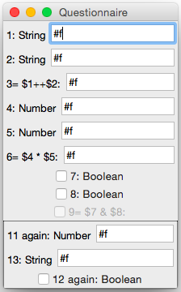
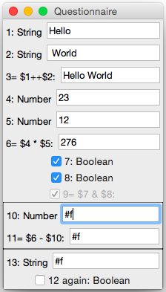
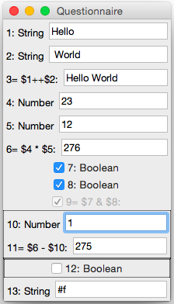
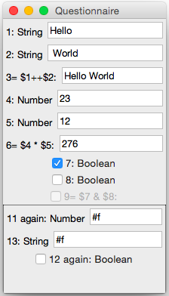
Language Workbench Challenge 2013
RACR solution: incremental update of computed values & rendering.

Slide 50
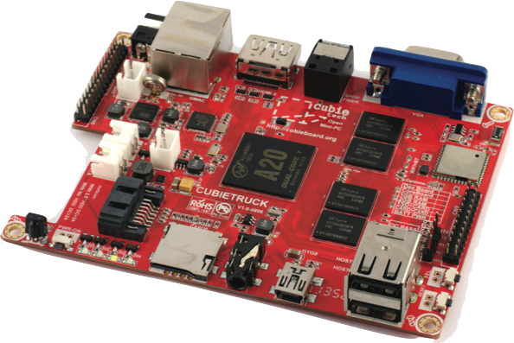
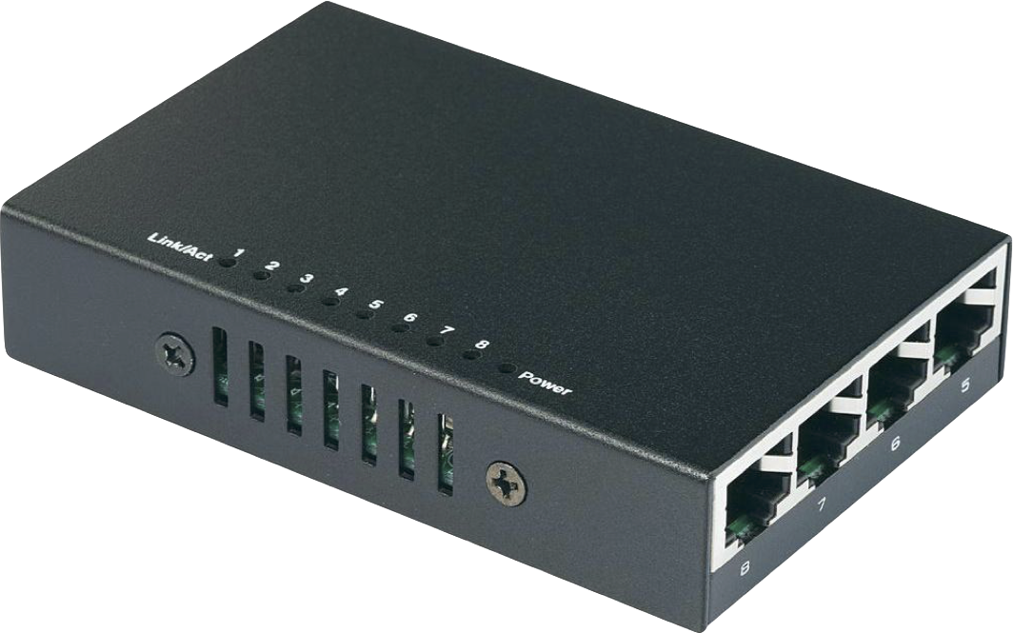
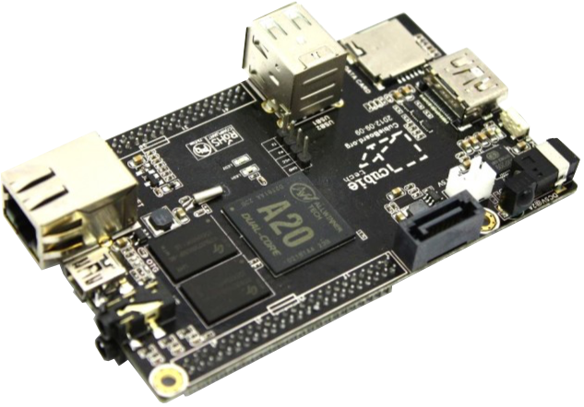
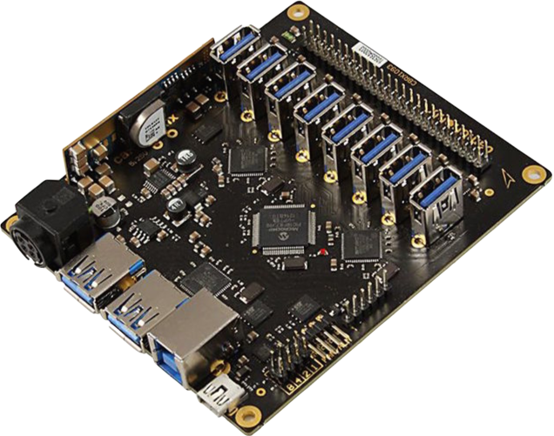

Energy auto-tuning case study
events
(indexing requests,
device removed/unavailable, etc.)
CubieTruck
(master)
Reference
Christoff Bürger et al.
Using Reference Attribute Grammar-Controlled Rewriting for Energy Auto-Tuning
10th International Workshop on Models@run.time,
CEUR-WS.org, 2015
power control link
real world
web interface
power link
network link
observe
controller
event queue & dispatch
updates (rewrites)
Cambrionix
(power)
abstract syntax graph (runtime model)
switch
virtual world
CubieBoard
(worker)
RACR solution: incremental energy efficient scheduling of indexing tasks.

Slide 51
The intention What are you up to?
RAG-controlled rewriting for incremental runtime models

Slide 52
Intended application: runtime models
real world
limitations of application
open research question
world model & controller
interactive, mutual-dependent analyses & transformations
analyses guide transformations
RACR
transformations invalidate analyses
analyses
updates

Slide 53
The conclusion What was it all about?
RAG-controlled rewriting enables incremental, interactive, mutual-dependent analyses and transformations

Slide 54
What was it all about?
RAG-controlled rewriting
enables interactive, mutual-dependent Analyses and Transformations
by seamlessly combining Reference Attribute Grammars and Graph Rewriting
such that Analyses can Guide and Deduce Rewrites
and Rewrites Update Analyses they influence
using a well-balanced set of Query- and Rewrite-Functions
constructing a Dynamic Attribute Dependency Graph
that can be used for Dynamic Attribute Invalidation
achieving Incremental Analyses and Transformations
incremental, interactive, mutual-dependent analyses and transformations

Slide 55
Backup slides
Dynamic dependency over-approximations

Slide 56
Dynamic dependency over-approximations
declaration is deleted
Prog
Stmt*
DErr
t
Decl
Block
Use
Decl
b
g
b
l
b
g
b
l
t
w
g
l
t
w
index
index
Integer
a
Stmt*
b
Real
a
always invalidate when queried information changes
dynamic dependency over-approximations
b
g
Use
a
l
t
w
g
Use
a
l
t
w
a
g
Decl
a
l
t
w
a
g
Use
l
t
w
index
b
index
index
pessimistic (correct), generic, algorithmic approach,
not dynamic invariant proof
b
a
Real
a
a

